Slide 1
PART – A
EMPLOYABILITY SKILL
Self-management Skills
Artificial Intelligence - (417)
SELF MANAGEMENT SKILL#easy2learn with jyoti

Slide 2
WHAT IS SELF-MANAGEMENT?
Self-management refers to managing our life in a way so that we lead a satisfying life in any type of
challenge, situation & in chronic conditions.
SELF MANAGEMENT SKILL#
easy2learn with jyoti
Self-management broadly involves the following domains of Skills:
Stress Management
Self-Awareness
Self-Motivation
Set Goals
Time Management

Slide 3
SELF MANAGEMENT SKILL#
easy2learn with jyoti

Slide 4
SELF MANAGEMENT SKILL#
easy2learn with jyoti

Slide 5
SELF MANAGEMENT SKILL#
easy2learn with jyoti

Slide 6
SELF MANAGEMENT SKILL#
easy2learn with jyoti

Slide 7
SELF MANAGEMENT SKILL#
easy2learn with jyoti

Slide 8
WHAT IS STRESS?
Stress is our body and mind’s response and reaction to challenging situations in our lives. It is our body’s way of reacting and getting prepared to deal with a situation and pressure it creates.
“Stress refers to a “physical, mental or emotional strain or tension”.
SELF MANAGEMENT SKILL#
easy2learn with jyoti

Slide 9
EUSTRESS | DISTRESS
A Stress that remains for a little time and motivates one to strive harder and do well is called positive Stress or good stress or eustress. | Bad Stress refers to Stress that is ongoing & does not lower down.
Even though good stress affects our pulse rate but there is no fear with good stress or eustress. | Negative stress makes a person worrisome, less productive and may lead to various psychosomatic disorders too.
Example – Going for an Interview, The Deadline for assignment submission is approaching Riding a roller Coaster in an adventure park Going for paragliding. Note – Eustress Keeps us focused & motivated to do something. | Symptoms of Bad Stress are- Lack of Sleep Heart Problem Loss or Gain of Appetite Irritability Memory Loss Depression Weight Gain or Loss Problem in Focusing
SELF MANAGEMENT SKILL#
easy2learn with jyoti

Slide 10
Stress Management Technique
SELF MANAGEMENT SKILL#
easy2learn with jyoti

Slide 11
Physical Exercise –it helps boost up the production of our brain’s feel-good neurotransmitters called “endorphins”. Note - Dopamine & Serotonin are other such feel-good chemicals released in our body. Sports & Yoga are clubbed with physical exercise, as it brings positive impacts on our body.
2. Healthy Diet & Lifestyle – Healthy Diet & Physical activities increase the mind & body power in a multitude of ways.
3. Yoga– Yoga includes a series of postures and breathing exercises practiced to achieve control of body and mind.
4. Meditation – It is a practice where an individual is supposed to focus his/her mind on a particular object, thought, or activity to achieve a calm mental state reducing stress.
5. Positive Thinking & Outlook – Positive Outlook means having the confident belief that things will always work out for the best & expecting the best in life in general.
SELF MANAGEMENT SKILL#
easy2learn with jyoti

Slide 12
6. Taking Breaks & Good Sleep–Taking a break from the regular work or routine is a useful technique of lowering stress. small break can take up by reading, listening to music, and any other activity that does not take much time & gives you relaxation & joy. Sleep is also very important for relaxing & recharging brain, so that it is ready to function again the next day.
7. Organising Life– Organising life keeps life stress free and brings better results too.
8. Holidaying & Vacationing– it lowers stress level & controls CORTISOL in our body. It also releases feel-good hormones in our body, making us feel relaxed & Stress-free. Note – Cortisol is called a Stress Hormone. Another Stress Hormone is Adrenaline.
9. Taking Nature Walks - Spending time in Natural Surroundings having forests, and parks on trees help to have increased immunity.
SELF MANAGEMENT SKILL#
easy2learn with jyoti

Slide 13
NOTE
➔ CORTISOL and ADRENALINE are stress hormones. It is released in our body when there are increased stress levels.
Endorphins, Dopamine & Serotonin are our body’s feel-good chemicals that are released in the brain and help us cope with stress.
SELF MANAGEMENT SKILL#easy2learn with jyoti
Notes:
Natural Environments can have very positive effects on Human Health. Spending some Tiem in Vegetation rich area boosts emotional strength to face challenges & oppositions and help us live with enthusiasm. Green Spaces and parks in the surroundings help improve mental wellness & keep anxiety and depression away.
Studies show that spending time in natural surroundings having forests, and parks on trees helps to have increased immunity.

Slide 14
Independent Working
Ability to Work Independently
Proper Stress Management helps to develop an important ability to work independently.
Everyone who has been sent on this earth has been blessed in their own way. They together make this earth a beautiful place. Some can sing well, others are good at sports, some are intellectuals and some are good comedians. Everyone is special.
everyone must learn the art of working independently.
SELF MANAGEMENT SKILL#
easy2learn with jyoti

Slide 15
Importance of The Ability to Work Independently
Following benefits of working independently advocate its importance.
• you should take initiative.
You Take full responsibility for the work.
• you take ownership of it, i.e. you make yourself accountable for it.
• you are ready to do unsupervised work, i.e. you do not require constant
supervision.
• you are capable of completing the work within the stipulated time &
budget.
• You should maintain a work-life balance.
• It ensures creativity and satisfaction amongst individuals.

Slide 16
Emotional Intelligence
Emotional Intelligence refers to the ability to monitor & understand own & others’ feelings & emotions and take appropriate actions.
SELF MANAGEMENT SKILL#
easy2learn with jyoti

Slide 17
Self-Awareness
Self-awareness is the full understanding of self in terms of Strengths, Weaknesses, Interests, Abilities, Attitudes, Biases, and so forth with a knowledge of how one can utilize these.
Having conscious knowledge of your own self, capabilities, feelings, and one’s own character is called self-awareness.
It helps individuals to chart their ways of working independently.
They become aware of their strengths and weak points and work accordingly. They try to focus on strengths to become successful in various areas of life.
SELF MANAGEMENT SKILL#
easy2learn with jyoti

Slide 18
Self-Motivation
Self-motivation is the ability to do things on your own without being told to do so. It is a free within that lights our path & drives us to do & achieve something.
Self-motivated individuals have an inner urge to do something and achieve their goals without any external pressure/lure for awards or appreciation. It is a life skill and must be necessarily developed.
The best Motivation is Self-Motivation
SELF MANAGEMENT SKILL#easy2learn with jyoti

Slide 19
Self-Regulations – Goal Setting
Self-Regulation – Self –regulation inculcates discipline that helps in consistent efforts to move towards the goal.
Goal-setting – refers to the process of planning and taking active steps to achieve a specific Goal.
SELF MANAGEMENT SKILL#easy2learn with jyoti

Slide 20
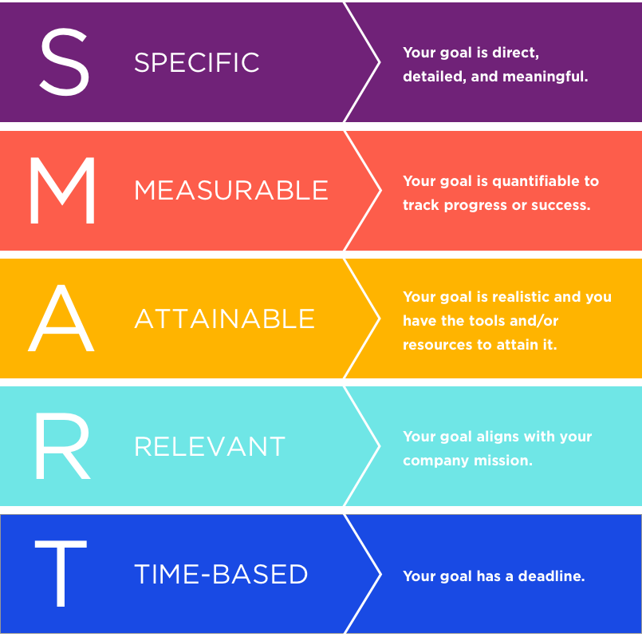
Smart Goal – Chosen Goals are clear & reachable, they should be Smart.
1. S - Specific – The goal should clearly specify what is to be achieved or accomplished. To set a specific goal one must answer the six ‘W’ questions.
Who – Who is Involved
What – What do I want to accomplish
Where – Identify a location
When – Establish a time frame.
Which – Identify requirements and constraints.
Why – Specific reasons, purpose, or benefits of accomplishing the goal.
Example – the general goal would be, ‘get in Shape.’
But a specific goal would be to ‘ Join a Gym or Yoga class & work out 3 days a week.’
2. M-Measurable – I should lose weight of 4-7 kgs in 45 days.
SELF MANAGEMENT SKILL#easy2learn with jyoti

Slide 21
3. A -Attainable – The Goal should be attainable and achievable. Example- To
lose 4-6 kg, my daily aim of losing weight is 250-300g.
4. R- Realistic - Unrealistic Goals are a waste of time.
Example of unrealistic Goal- Losing weight of 10 kg in 5 days.
Example of Realistic Goal - I should lose weight of 4-7 kg in 45 days.
5. T- Time-bound – If you want to lose 10 kgs, when do you want to lose it by?

Slide 22
Time Management
Time Management refers to the planning out of available time and controlling the amount of time to be spent on specific tasks in order to work more efficiently.
SELF MANAGEMENT SKILL#easy2learn with jyoti

Slide 23
Significance of Time Management
It Improves Performance – we can prioritize tasks & give the required time
to each task as per their priority,
It delivers better work quality – with proper time allocation and no rushing,
the work is completed in a settled & happy environment.
Timely delivery – with proper time management work is delivered on time
which gives great satisfaction to both the client and the workforce.
Brings more efficiency – Time Management not only ensures timely & quality delivery but also contributes to the confidence & efficiency of the workforce & work culture too.
Reduces Stress – it builds happy, stress-free relations between client and workforce..
SELF MANAGEMENT SKILL#easy2learn with jyoti

Slide 24
Consequences of Poor Time Management
Poor Quality work
Missing deadlines
Increased stress levels
Ruined or disturbed work-life balance
Professional reputation at stake.
SELF MANAGEMENT SKILL#easy2learn with jyoti

Slide 25
Steps of Effective Time Management
ORGANIZE
PRIORITIZE
CONTROL
TRACK
#easy2learn with jyoti

Slide 26
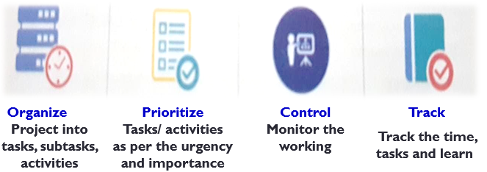
Steps of Effective Time Management
SELF MANAGEMENT SKILL#easy2learn with jyoti

Slide 27
TIME MANAGEMENT TIPS
Stick to the schedule, avoid delays & procrastination(टाल मटोल).
Start with Urgent & important tasks first.
Do one thing at a time, resist diversions & do not multitask.
Plan for the unexpected
Learn to say “No”
Delegate activities/assignments wherever possible.
When you delegate, entrust(सौंप देना.) Educate the people & turn the project over to them.
Make sure you follow up.
To make a decision, gather available facts, make the decision, and put it into effect.
Keep your workspace free from clutter (अस्त व्यस्त करना).
Note –
Procrastination is one big hindrance in effective time management.
SELF MANAGEMENT SKILL#easy2learn with jyoti

Slide 28
Thank you

